Slide 1
CAN Properties
AGENDA
Wired – Wireless
Serial – Parallel
Synchronous – Asynchronous
Peer2Peer – Broadcast
Message Based Protocol
Message Filtering
Simplex – Half Duplex – Full Duplex
Acknowledgement method
CSMA-CA Protocol
Temporary and Permanent Node failures
Shyam Bhat
VicharaVandana

Slide 2
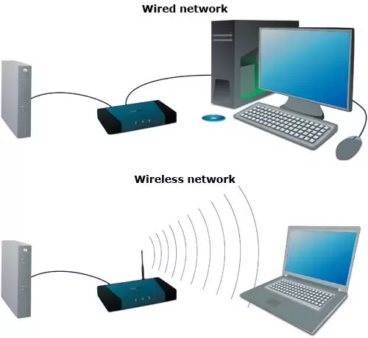
Wired and Wireless Communication
Telephone is Wired and Mobile is wireless
Wireless Protocols
Bluetooth,
WIFI
Wired Protocols
Ethernet
CAN
When we go for Wired and when we go for Wireless?
CAN is a Wired Protocol – Bus Topology

Slide 3
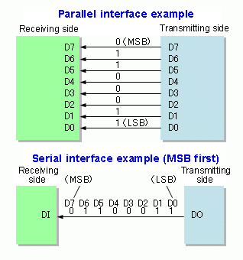
Serial and Parallel Communication
How many bits can the bus carry simultaneously
N = 1 → Serial communication
N > 1 → Parallel communication
Parallel Bus: Data Bus, Address Bus etc within microcontroller
Serial Bus: SPI, LIN, I2C etc
CAN is SerialBus protocol with MSB going first

Slide 4
Synchronous & Asynchronous
Here the Time factor comes in. At what point of time can a node start transmitting the frame on the Bus.
Synchronous: If a node has a frame to transmit, then it has to wait till its slot. The time units are quantized and Nodes can transmit at particular point of time only. Here all the nodes are in synch always and hence the name. Tx and Rx nodes are synchronized with respect to time or clock. Eg: SPI, Flexray
Asynchronous: If a node has a frame to transmit, then it can initiate the transmission at any time. The nodes (Rx and Tx) will be synchronized based on the frame itself and no separate clock signal is needed.
CAN is a Asynchronous Communication Protocol

Slide 5
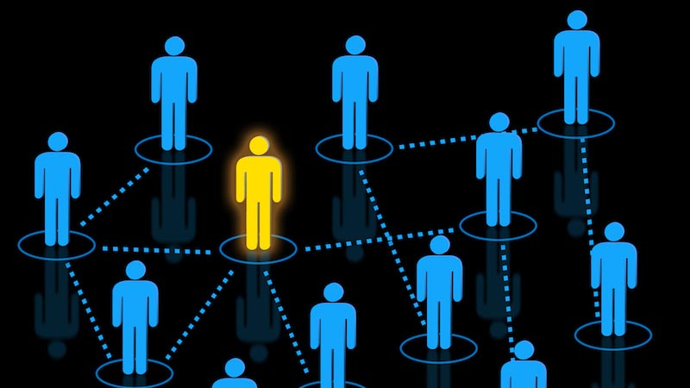
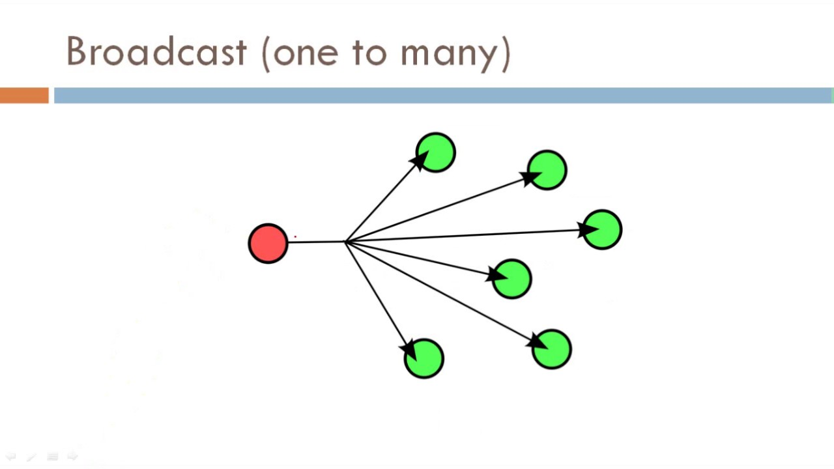
Peer to Peer & Broadcast
Peer-to-Peer is like mobile phone and Broadcast is like FM Radio.
Example of Peer-to-Peer protocols: Ethernet which uses Switch, SPI which uses CS.
Example of Broadcast protocols: CAN, Flexray
CAN Protocol is a Multicast (Similar to Broadcast) type.

Slide 6
Message Based Protocol
CAN protocol is message based protocol and not Node based protocol.
Each CAN frame is identified with Message ID and no info about the Tx or Rx node.
Node based Can be understood with mobile phones. Usually Peer-Peer are node based.
Since CAN is multicast, It is message based protocol.
Message ID has 3 purpose:
Identify the Data carried by the frame
Decides the message Priority and hence decides which frame gets the bus if clash happens.
Used in Message Filtering

Slide 7
Message Filtering
Node D is transmitting the frame. Node A,B, C are getting the Message. Node A and B filters the message IN and Node C Filters message Out
Filtering of Frame happens depending on Message ID.
Message filtering happens within CAN controller hardware using 2 configured parameters called as mask and filter.

Slide 8
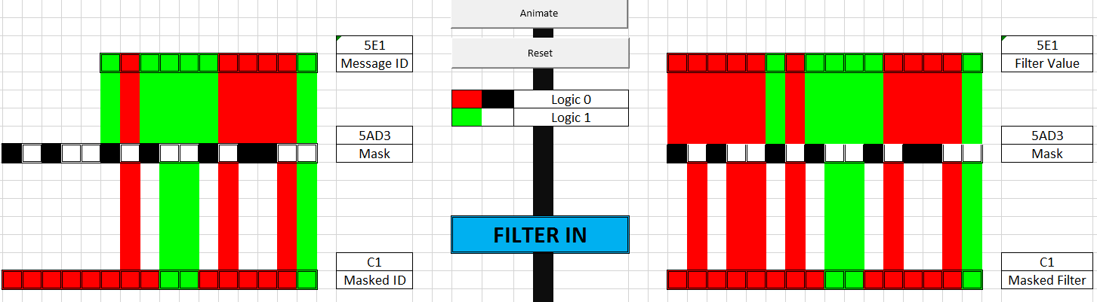
Message Filtering Logic
if (Message_ID & Mask) == (Filter_Val & Mask) {
Let the Message IN
}
else {
Ignore the Message
}
Msg ID : 5E1
Filter : 5E1
Mask : 5AD3

Slide 9
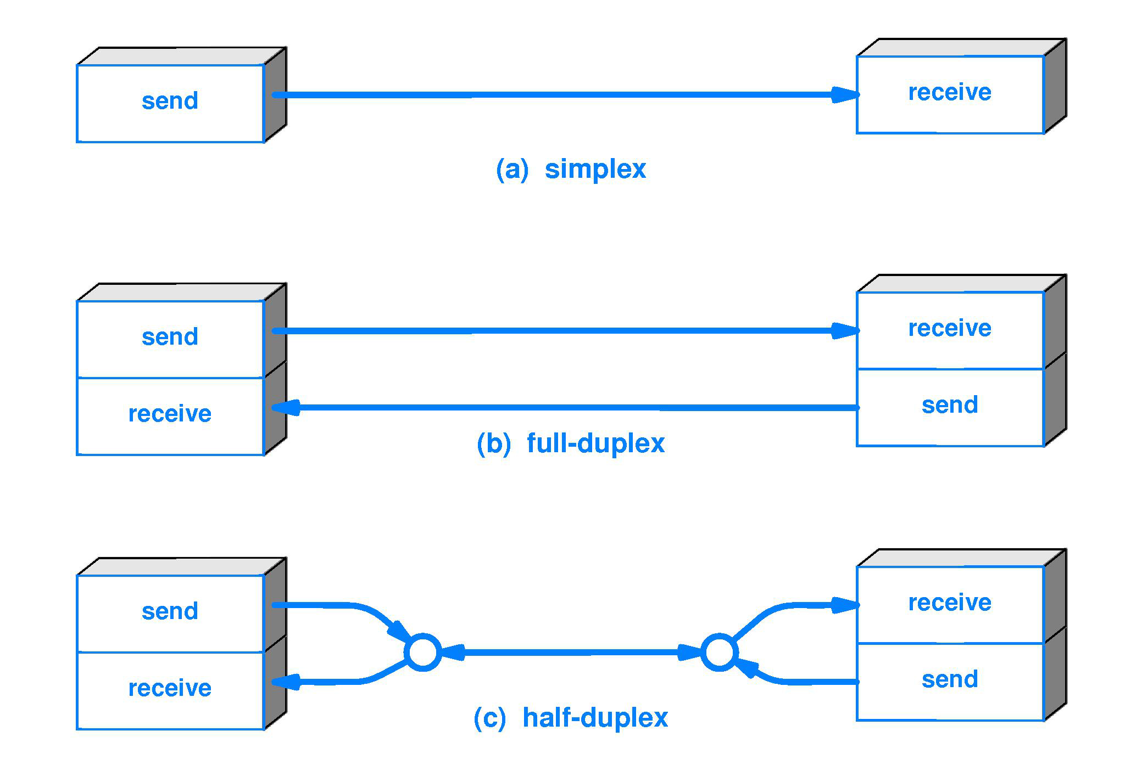
Simplex – Half Duplex – Full Duplex
CAN Protocol is a Half-Duplex Communication.

Slide 10
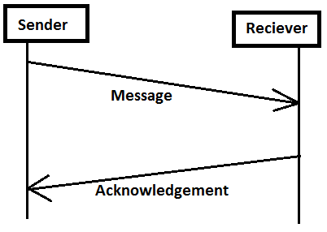
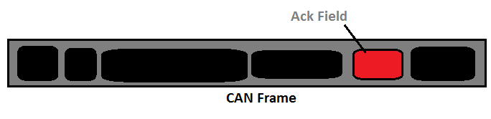
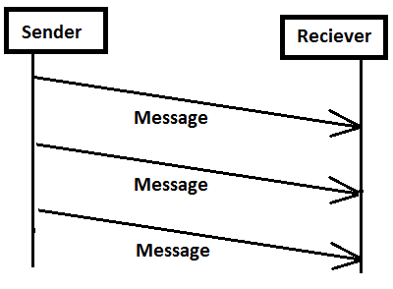
Acknowledgement Method
CAN has a beautiful acknowledgement method
There is no separate acknowledgement frame
In every frame, there is a special Acknowledgement field where The Receivers will acknowledge proper reception of data to them.
SO Ack is achieved without increasing the Bus load.
This concept will be clear when frame format will be explained

Slide 11

CSMA-CA Protocol
CSMA-CA stands for Carrier Sense Multiple Access Collision Avoidance Protocol
CSMA
CA
CD
CR
I have a data to transmit
Listen to bus if any ongoing Tx
If free then only transmit
BUS
In CSMA : A transmitter attempts to determine whether another transmission is in progress before initiating a transmission using a carrier-sense mechanism
CA: Collision Avoidance → Doesn’t let collision happen between its frames
CD: Collision Detection → If collision happens between the frames, it is detected and a proper action taken.
CR: Collision Resolution → If collision happens between frames, its resolved in that instance only successfully.

Slide 12
Temporary and Permanent Node Failures
Temporary Node failure is when the current ongoing frame is destroyed by the node.
Permanent Node failure is when the node withdraws itself from the BUS communication. No Tx No Rx.

